Slide 1
Creating Demand for Differentiated Service Delivery
Solange Baptiste
Executive Director
International Treatment Preparedness Coalition (ITPC)

Slide 2
WHAT’S WRONG WITH THIS PICTURE?

Slide 3
KNOWLEDGE MAKES A WORLD OF DIFFERENCE

Slide 4
DEMAND CREATION
You can’t demand something that you don’t know about!
Notes:
When you try to do 2 things at once you end up doing one more/better than the other. Really hinges on your core motivation. Why are we doing this? Why are we talking about DSD?

Slide 5
DEMAND CREATION
The bedrock of ALL demand creation is EDUCATION (knowledge building).
Change
Advocacy
Demand Generation
Education
Notes:
When you try to do 2 things at once you end up doing one more/better than the other. Really hinges on your core motivation. Why are we doing this? Why are we talking about DSD?

Slide 6
WHY IS DSD FOR ART IMPORTANT?
MSF_HIV_report_Untangling-the-web-18thed_ENG_2016.pdf

Slide 7
COMMUNITY PERSPECTIVES FROM:
Rapid assessment on ‘readiness’ of patients and communities to advocate for differentiated models of ART delivery. [2016]
Three (3)-day gathering, with nearly 70 participants from all nine CQUIN countries. [2017]
A five (5)-day intensive community workshop on DSD with 30 activists across 12 countries from seven (7) networks of people living with HIV in Africa and Asia. [2017]
Small grants given to 17 PLHIV networks across the globe working DSD demand creation and advocacy [2018]
15 years of experience across 9 Regional ITPC Networks, Global & Regional CABs, Global Community Consultation on PrEP [2017], Community Global IP Summit [2017] and engagement with over 4000 CBOs.
Notes:
To develop a more nuanced understanding

Slide 8
INSIGHTS
Communities don’t know what DSD is
Only 18% of all PLHIV interviewed had heard of differentiated ART
However, when explained, all were open to it.
DSD is not new
“It’s a fancy term for what we have been doing all along or asking for all along!”
Notes:
Botswana – cross border issues. Sex workers from Zim who work in Bots, one person travels back to Zim to collect for the group because Zim has a DSD model that works to enable this.

Slide 9
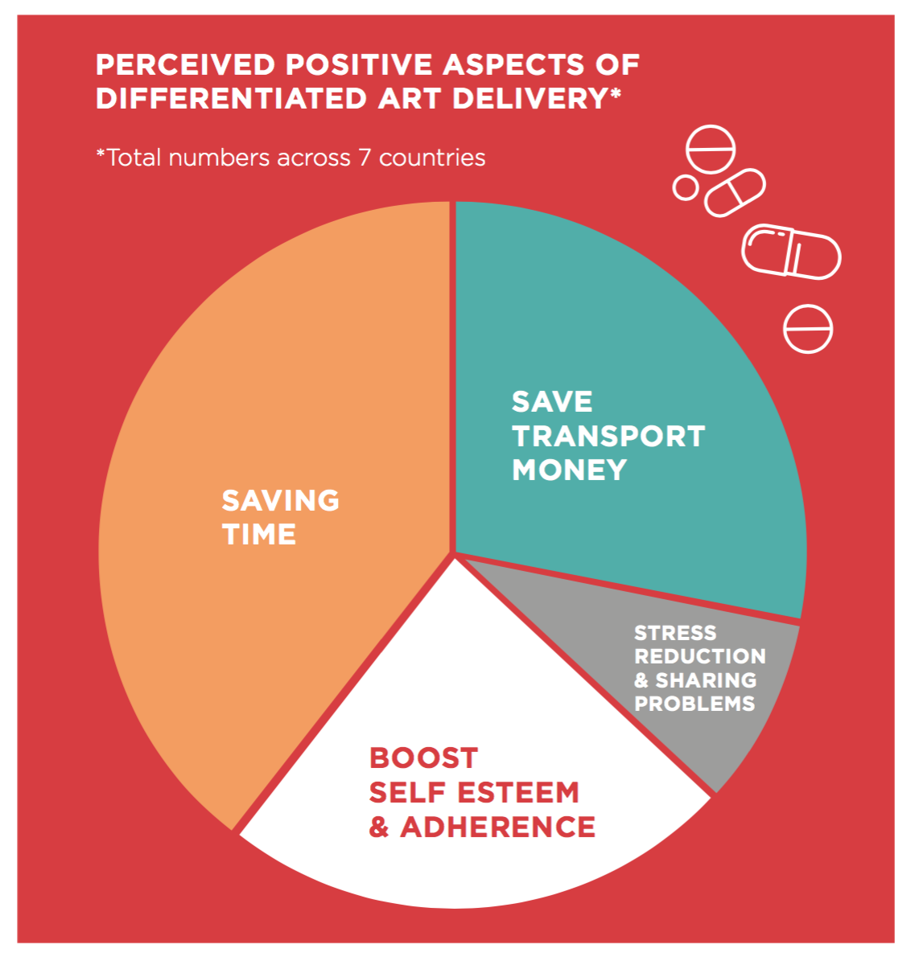
INSIGHTS
Respondents said that:
DSD would make collecting their ARVs easier.
They like the option of community drug distribution points (CDDPs) and a fast track window within the clinic the most.
DSD would save time and money, specifically regarding transport costs.
Potential negative impact - delivery of their ARVs closer to home would lead to exposure of their status and consequent stigma and discrimination.

Slide 10
INSIGHTS
“The first (fast track) would be the best for me because it allows me to safeguard the secret of my disease which is very important to avoid the discrimination in our environment, and for the safeguarding of these secrets, only the doctor is able to do it better than anyone else.” (Online survey: Female respondent, 35-49)
.
“Most of us would not like other people to know their health status. AIDS is still perceived as a shameful disease. If people, especially my friends, know I am a victim, they might abandon me. (Girl, 15-20, Tanzania coastal District)
.
Healthcare worker respondents expressed concerns that:
Adolescents and key populations would be particularly worried about doing anything that might expose their status to their friends or broader community.
Roll-out of differentiated ART delivery models would need to be accompanied by comprehensive training for health care workers (what will be different and lost) and the implementation of treatment literacy programs to educate communities about differentiated ART delivery.

Slide 11
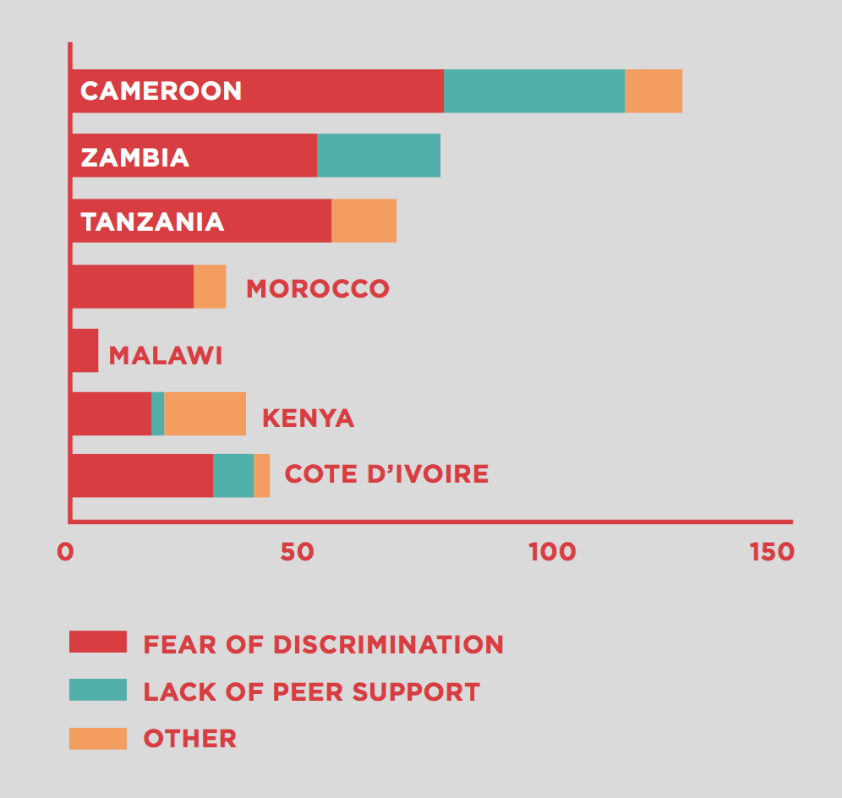
INSIGHTS
Potential negative impact of DSD models
Fear of discrimination and avoidance of any model that involves drug collection closer to home
If it is not broken, don’t fix it
Lack of peer support
Perception that tx and care would be compromised by less frequent visits
Notes:
Perceptions of obstacles or negative impact in terms of care and treatment (Responses in percentages of total numbers).
37 % of all PLHIV interviewed across the seven countries expressed the fear that delivery of their ARVs closer to home would lead to exposure of their status and concomitant stigma and discrimination. The country specific results varied widely with only 2 % of respondents in Malawi mentioning this as a concern compared to 79 % of respondents from Cameroon. The ‘other’ category included concerns relating to treatment and care being compromised by less frequent visits to the clinic. Many respondents also expressed discomfort around changing a system that they were used to and doctors or health workers that they were comfortable with.
The fear of stigma and discrimination was also expressed strongly among certain groups such as younger respondents. Health workers suggested that adolescents and other marginalized groups such as MSM and sex workers experience high levels of self-stigma and might avoid any care model, which involves drug collection closer to their homes.

Slide 13
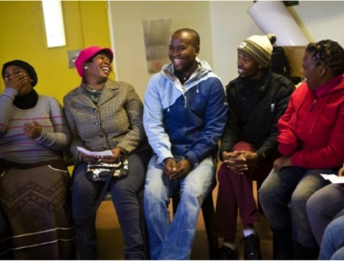
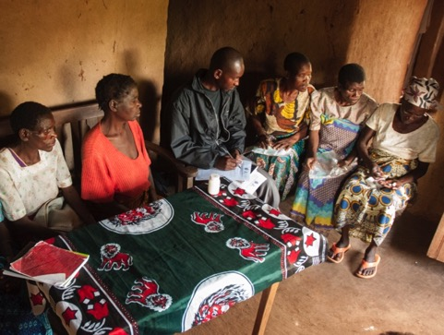
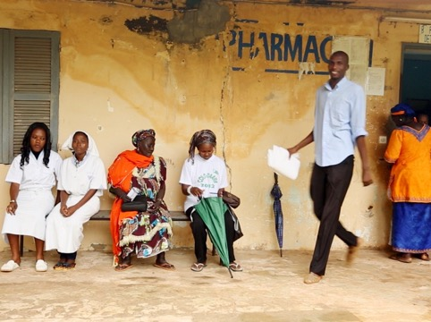
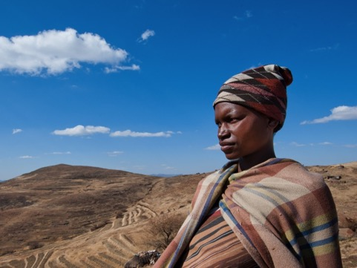
Health care worker-managed group
Client-managed group
Facility-based individual
Out-of-facility individual

Slide 14
WHAT DSD IS NOT…
Pick one of 4 models
A substitute for good care/services
Tailored/individualized care or services

Slide 15
WHAT WORKS FOR ME: Activist Toolkit for DSD

Slide 16
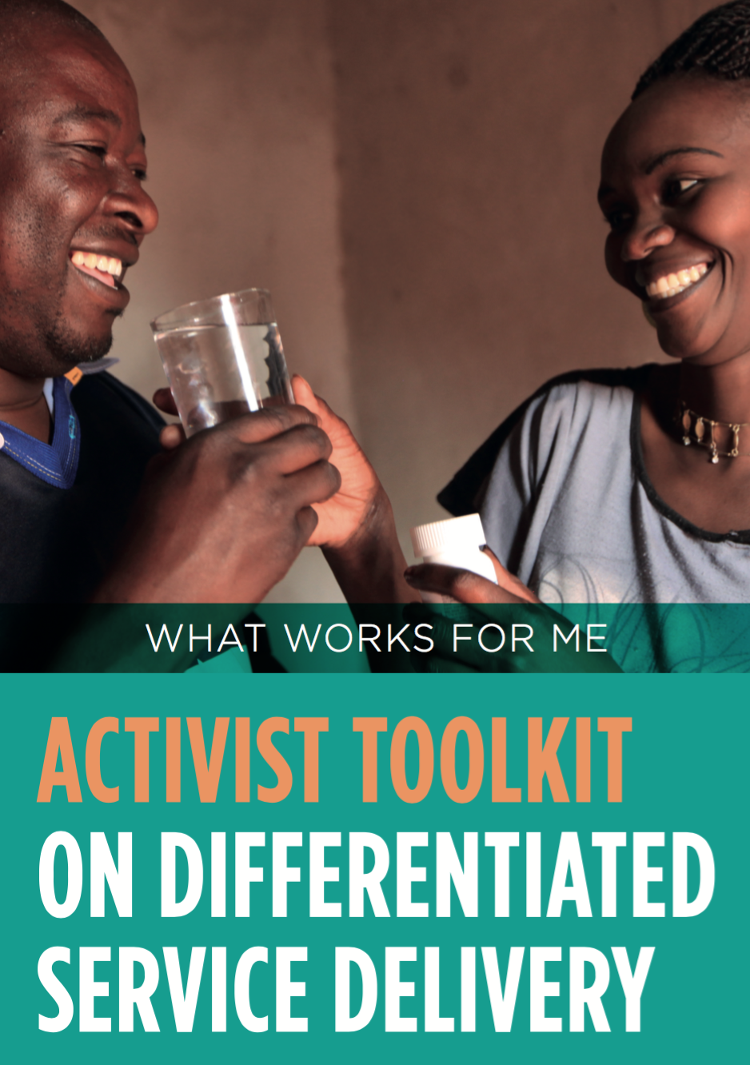
Available for download at: www.itpcglobal.org/resources/what-works-for-me

Slide 17
PUSHING TO IMPLEMENT DSD – India
Draftitis
Community groups advocated and pushed government to adopt the policy
Development and integration of community SOPs into the treatment guidelines
Launch of DSD community center in Gujarat,
25 ROC who were referred by the ART centers for Community Adherence Group (CAG model)
Challenges include:
Staff not yet fully comfortable with the concept of the DSD and providing this level of service (what about complications etc.)
Issues with TB/PLHIV ROC, since patient need to receive treatment from facilities for 6 months before being be referred in to the CAGs.

Slide 18
PUSHING TO SCALE UP DSD – Zimbabwe
A country with a national DSD policy
Through small grants focused on DSD and RVLT, communities successfully pushed to establish and scale models within national DSD programs with D on ART delivery
In Harare, 3 health facilities are now offering 4 models (vs 1) (fast-track windows, CAGs delinked)
Pilot of community treatment observatory in Zimbabwe
Routine data collection
Indicators along the cascade
Help to inform advocacy to improve and scale up DSD and RVLT uptake

Slide 19
DSD for PREVENTION
“I tested (for HIV) in 1998, I have never fallen sick my viral load is undetectable. I’m not sick. Why should I stand in three or more hours queue just to get my drugs? I have a life, I work!” – a PHIV Leader, Tanzania
Perspective of someone living with HIV
How do we get well people to test for HIV?
What does the model for attracting people who don’t feel sick or don’t perceive themselves as being at high risk of getting HIV into the health care system?
Notes:
System need to adapt to the concept that has been there all along.

Slide 20
CAN’T EFFECTIVELY IMPLEMENT AND SCALE DSD WITHOUT:
Robust COMMUNITY MONITORING: to monitor quality and access of services along the HIV cascade
Understanding how to scale and improve QUALITY (not just #s)
Building COMMUNITY SYSTEMS
Truly supporting the shift to more COMMUNITY-LED & PROVIDED SERVICES
Funding COMMUNITY ADVOCACY: to ensure there is a strong community voice in the design, implementation and scale of interventions

Slide 21
What is DSD?
Differentiated service delivery,
is a recipient of care-centered approach that simplifies and adapts HIV services ascross the cascade, in ways that both
serve the needs of PLHIV better
and
reduce unnecessary burdens
on the health system.
Notes:
When you try to do 2 things at once you end up doing one more/better than the other. Really hinges on your core motivation. Why are we doing this? Why are we talking about DSD?

Slide 22
Notes:
When you try to do 2 things at once you end up doing one more/better than the other. Really hinges on your core motivation. Why are we doing this? Why are we talking about DSD?

